Slide 1
DATA STRUCTURES & ALGORITHMS WITH JAVA
Lesson 5: Linked List & Stack

Slide 2
Linked List
Section 1

Slide 3
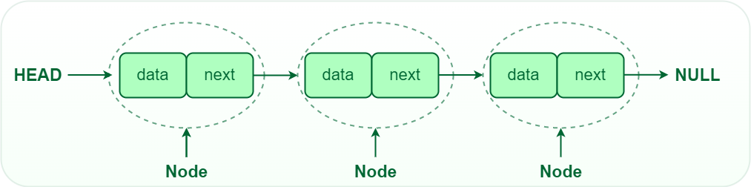
Basics of Linked List
Linked List is a linear data structure, in which elements are not stored at a contiguous location, rather they are linked using pointers. Linked List forms a series of connected nodes, where each node stores the data and the address of the next node.
Notes:
Node Structure: A node in a linked list typically consists of two components: Data: It holds the actual value or data associated with the node. Next Pointer: It stores the memory address (reference) of the next node in the sequence. Head and Tail: The linked list is accessed through the head node, which points to the first node in the list. The last node in the list points to NULL or nullptr, indicating the end of the list. This node is known as the tail node.

Slide 4
Why linked list data structure needed?
Dynamic Data structure: The size of memory can be allocated or de-allocated at run time based on the operation insertion or deletion.
Ease of Insertion/Deletion: The insertion and deletion of elements are simpler than arrays since no elements need to be shifted after insertion and deletion, Just the address needed to be updated.
Efficient Memory Utilization: As we know Linked List is a dynamic data structure the size increases or decreases as per the requirement so this avoids the wastage of memory.
Implementation: Various advanced data structures can be implemented using a linked list like a stack, queue, graph, hash maps, etc.
Notes:
Dynamic Data structure: The size of memory can be allocated or de-allocated at run time based on the operation insertion or deletion.
Ease of Insertion/Deletion: The insertion and deletion of elements are simpler than arrays since no elements need to be shifted after insertion and deletion, Just the address needed to be updated.
Efficient Memory Utilization: As we know Linked List is a dynamic data structure the size increases or decreases as per the requirement so this avoids the wastage of memory.
Implementation: Various advanced data structures can be implemented using a linked list like a stack, queue, graph, hash maps, etc.

Slide 5
Types of linked lists
Single-linked list
Double linked list
Circular linked list

Slide 6
Single-linked list
In a singly linked list, each node contains a reference to the next node in the sequence. Traversing a singly linked list is done in a forward direction.

Slide 7
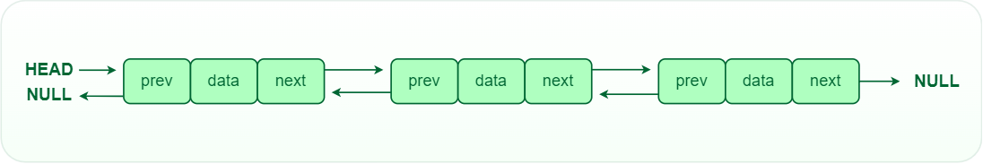
Double-linked list
In a doubly linked list, each node contains references to both the next and previous nodes. This allows for traversal in both forward and backward directions, but it requires additional memory for the backward reference.

Slide 8
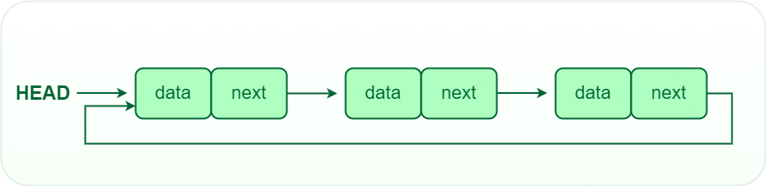
Circular linked list
In a circular linked list, the last node points back to the head node, creating a circular structure. It can be either singly or doubly linked.

Slide 9
Operations on Linked Lists
Insertion: Adding a new node to a linked list involves adjusting the pointers of the existing nodes to maintain the proper sequence. Insertion can be performed at the beginning, end, or any position within the list
Deletion: Removing a node from a linked list requires adjusting the pointers of the neighboring nodes to bridge the gap left by the deleted node. Deletion can be performed at the beginning, end, or any position within the list.
Searching: Searching for a specific value in a linked list involves traversing the list from the head node until the value is found or the end of the list is reached.

Slide 10
Advantages & Disadvantages
Dynamic Size: Linked lists can grow or shrink dynamically, as memory allocation is done at runtime.
Insertion and Deletion: Adding or removing elements from a linked list is efficient, especially for large lists.
Flexibility: Linked lists can be easily reorganized and modified without requiring a contiguous block of memory.
Random Access: Unlike arrays, linked lists do not allow direct access to elements by index. Traversal is required to reach a specific node.
Extra Memory: Linked lists require additional memory for storing the pointers, compared to arrays.
Notes:
Linked lists are versatile data structures that provide dynamic memory allocation and efficient insertion and deletion operations. Understanding the basics of linked lists is essential for any programmer or computer science enthusiast. With this knowledge, you can implement linked lists to solve various problems and expand your understanding of data structures and algorithms.
Advantages of Linked Lists:
Dynamic nature: Linked lists are used for dynamic memory allocation.
Memory efficient: Memory consumption of a linked list is efficient as its size can grow or shrink dynamically according to our requirements, which means effective memory utilization hence, no memory wastage.
Ease of Insertion and Deletion: Insertion and deletion of nodes are easily implemented in a linked list at any position.
Implementation: For the implementation of stacks and queues and for the representation of trees and graphs.
The linked list can be expanded in constant time.
Disadvantages of Linked Lists:
Memory usage: The use of pointers is more in linked lists hence, complex and requires more memory.
Accessing a node: Random access is not possible due to dynamic memory allocation.
Search operation costly: Searching for an element is costly and requires O(n) time complexity.
Traversing in reverse order: Traversing is more time-consuming and reverse traversing is not possible in singly linked lists.
Applications of Linked List:
Here are some of the applications of a linked list:
Linear data structures such as stack, queue, and non-linear data structures such as hash maps, and graphs can be implemented using linked lists.
Dynamic memory allocation: We use a linked list of free blocks.
Implementation of graphs: Adjacency list representation of graphs is the most popular in that it uses linked lists to store adjacent vertices.
In web browsers and editors, doubly linked lists can be used to build a forwards and backward navigation button.
A circular doubly linked list can also be used for implementing data structures like Fibonacci heaps.

Slide 11
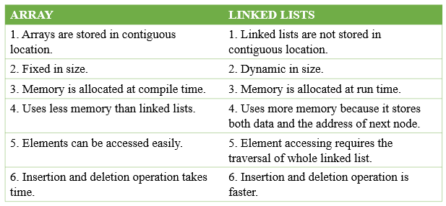
Linked List vs. Array

Slide 12
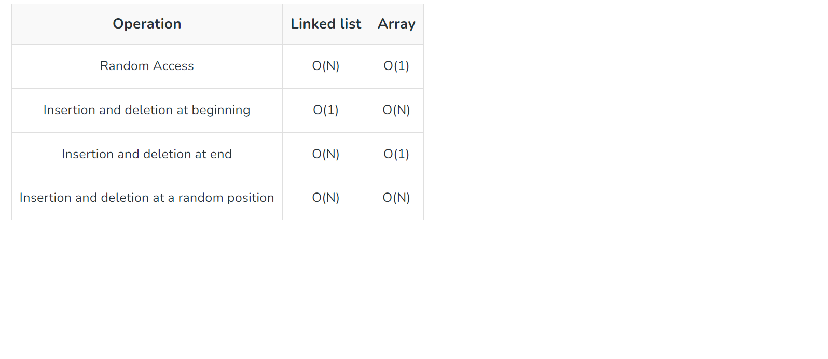
Linked List vs. Array in Time Complexity

Slide 13
Applications of Linked List
Linear data structures such as stack, queue, and non-linear data structures such as hash maps, and graphs can be implemented using linked lists.
Dynamic memory allocation: We use a linked list of free blocks.
Implementation of graphs: Adjacency list representation of graphs is the most popular in that it uses linked lists to store adjacent vertices.
In web browsers and editors, doubly linked lists can be used to build a forwards and backward navigation button.
A circular doubly linked list can also be used for implementing data structures like Fibonacci heaps.

Slide 14
Applications of Linked Lists in real world
The list of songs in the music player is linked to the previous and next songs.
In a web browser, previous and next web page URLs are linked through the previous and next buttons.
In the image viewer, the previous and next images are linked with the help of the previous and next buttons.
Switching between two applications is carried out by using “alt+tab” in windows and “cmd+tab” in mac book. It requires the functionality of a circular linked list.
In mobile phones, we save the contacts of people. The newly entered contact details will be placed at the correct alphabetical order.
This can be achieved by a linked list to set contact at the correct alphabetical position.
The modifications that we made in the documents are actually created as nodes in doubly linked list. We can simply use the undo option by pressing Ctrl+Z to modify the contents. It is done by the functionality of a linked list.

Slide 15
Practice
https://leetcode.com/tag/linked-list/
https://leetcode.com/problems/merge-two-sorted-lists/
https://leetcode.com/problems/remove-duplicates-from-sorted-list/
https://leetcode.com/problems/delete-node-in-a-linked-list/

Slide 16
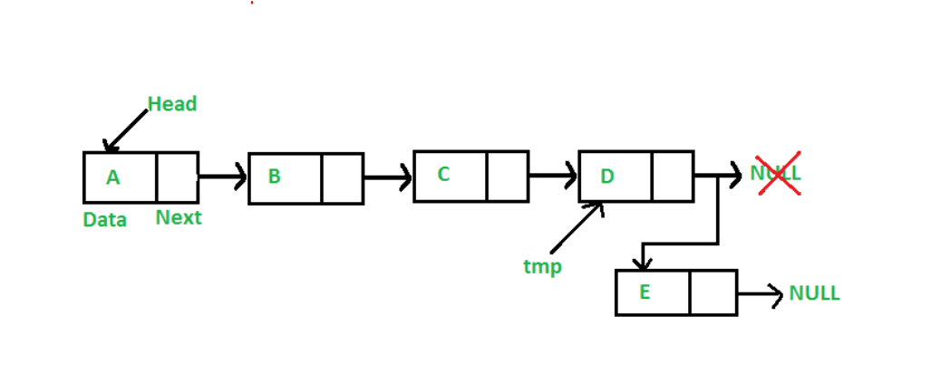
Insert

Slide 17
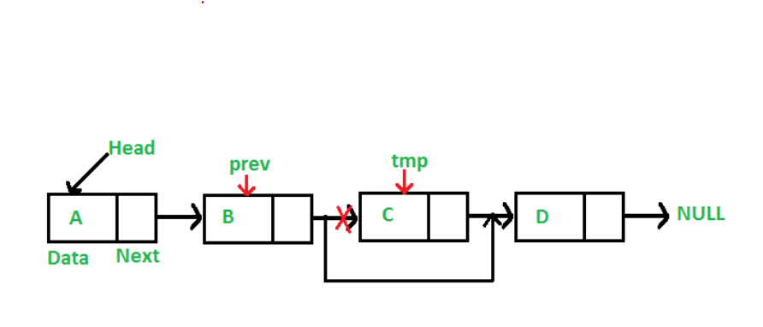
Delete

Slide 18
Stack Data Structure
Section 1

Slide 19
What is Stack?
A stack is a linear data structure in which the insertion of a new element and removal of an existing element takes place at the same end represented as the top of the stack.
LIFO(Last In First Out)
FILO(First In Last Out)

Slide 20
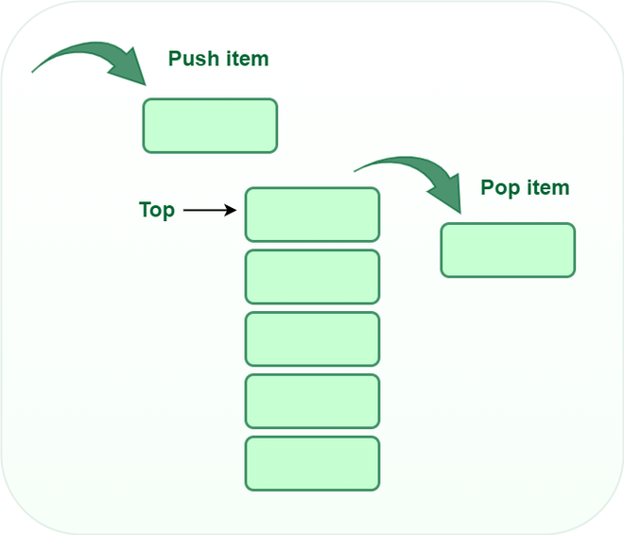
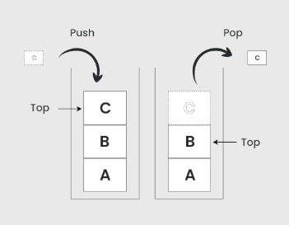

Slide 21
Operations
push() to insert an element into the stack
pop() to remove an element from the stack
top() Returns the top element of the stack.
isEmpty() returns true if stack is empty else false.
size() returns the size of stack.

Slide 22
Push
Adds an item to the stack. If the stack is full, then it is said to be an Overflow condition.
begin
if stack is full
return
endif
else
increment top
stack[top] assign value
end else
end procedure

Slide 23
Pop
Removes an item from the stack. The items are popped in the reversed order in which they are pushed. If the stack is empty, then it is said to be an Underflow condition.
begin
if stack is empty
return
endif
else
store value of stack[top]
decrement top
return value
end else
end procedure

Slide 24
Top
Returns the top element of the stack.
begin
return stack[top]
end procedure

Slide 25
isEmpty
Returns true if the stack is empty, else false.
begin
if top < 1
return true
else
return false
end procedure

Slide 26
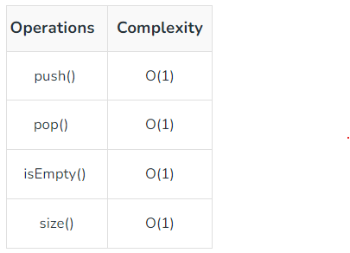
Time Complexity

Slide 27
Types of Stacks
Fixed Size Stack: As the name suggests, a fixed size stack has a fixed size and cannot grow or shrink dynamically. If the stack is full and an attempt is made to add an element to it, an overflow error occurs. If the stack is empty and an attempt is made to remove an element from it, an underflow error occurs.
Dynamic Size Stack: A dynamic size stack can grow or shrink dynamically. When the stack is full, it automatically increases its size to accommodate the new element, and when the stack is empty, it decreases its size. This type of stack is implemented using a linked list, as it allows for easy resizing of the stack.
Notes:
In addition to these two main types, there are several other variations of Stacks, including:
Infix to Postfix Stack: This type of stack is used to convert infix expressions to postfix expressions.
Expression Evaluation Stack: This type of stack is used to evaluate postfix expressions.
Recursion Stack: This type of stack is used to keep track of function calls in a computer program and to return control to the correct function when a function returns.
Memory Management Stack: This type of stack is used to store the values of the program counter and the values of the registers in a computer program, allowing the program to return to the previous state when a function returns.
Balanced Parenthesis Stack: This type of stack is used to check the balance of parentheses in an expression.
Undo-Redo Stack: This type of stack is used in computer programs to allow users to undo and redo actions.

Slide 28
Applications of the stack
Infix to Postfix /Prefix conversion
Redo-undo features at many places like editors, photoshop.
Forward and backward features in web browsers
Used in many algorithms like Tower of Hanoi, tree traversals, stock span problems, and histogram problems.
Backtracking is one of the algorithm designing techniques. Some examples of backtracking are the Knight-Tour problem, N-Queen problem, find your way through a maze, and game-like chess or checkers in all these problems we dive into someway if that way is not efficient we come back to the previous state and go into some another path. To get back from a current state we need to store the previous state for that purpose we need a stack.

Slide 29
Applications of the stack (cont…)
In Graph Algorithms like Topological Sorting and Strongly Connected Components
In Memory management, any modern computer uses a stack as the primary management for a running purpose. Each program that is running in a computer system has its own memory allocations
String reversal is also another application of stack. Here one by one each character gets inserted into the stack. So the first character of the string is on the bottom of the stack and the last element of a string is on the top of the stack. After Performing the pop operations on the stack we get a string in reverse order.
Stack also helps in implementing function call in computers. The last called function is always completed first.
Stacks are also used to implement the undo/redo operation in text editor.

Slide 30
Advantages & Disadvantages
Easy to implement.
Memory is saved as pointers are not involved.
It is not dynamic i.e., it doesn’t grow and shrink depending on needs at runtime. [But in case of dynamic sized arrays like vector in C++, list in Python, ArrayList in Java, stacks can grow and shrink with array implementation as well].
The total size of the stack must be defined beforehand.

Slide 31
Practice
https://leetcode.com/tag/stack/
https://leetcode.com/problems/valid-parentheses/
https://leetcode.com/problems/binary-tree-preorder-traversal/
https://leetcode.com/problems/remove-duplicate-letters/

Slide 32
Queue
Section 3

Slide 33
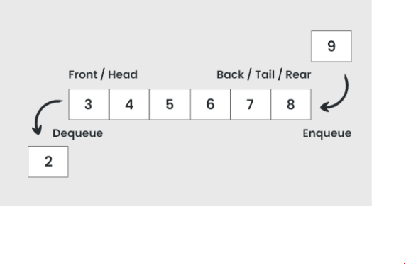
What is Queue Data Structure?
A Queue is defined as a linear data structure that is open at both ends and the operations are performed in First In First Out (FIFO) order.

Slide 34
FIFO Principle of Queue
A Queue is like a line waiting to purchase tickets, where the first person in line is the first person served. (i.e. First come first serve).
Position of the entry in a queue ready to be served, that is, the first entry that will be removed from the queue, is called the front of the queue(sometimes, head of the queue), similarly, the position of the last entry in the queue, that is, the one most recently added, is called the rear (or the tail) of the queue. See the below figure.

Slide 35
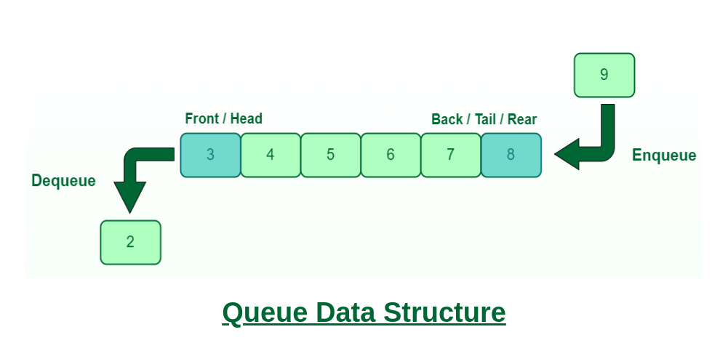
FIFO Principle of Queue

Slide 36
Characteristics
Queue can handle multiple data.
We can access both ends.
They are fast and flexible.

Slide 37
Queue Representation
Like stacks, Queues can also be represented in an array: In this representation, the Queue is implemented using the array. Variables used in this case are
Queue: the name of the array storing queue elements.
Front: the index where the first element is stored in the array representing the queue.
Rear: the index where the last element is stored in an array representing the queue.

Slide 38
Types of Queue
Input Restricted Queue: This is a simple queue. In this type of queue, the input can be taken from only one end but deletion can be done from any of the ends.
Output Restricted Queue: This is also a simple queue. In this type of queue, the input can be taken from both ends but deletion can be done from only one end.
Circular Queue: This is a special type of queue where the last position is connected back to the first position. Here also the operations are performed in FIFO order. To know more refer this.
Double-Ended Queue (Dequeue): In a double-ended queue the insertion and deletion operations, both can be performed from both ends. To know more refer this.
Priority Queue: A priority queue is a special queue where the elements are accessed based on the priority assigned to them

Slide 39
Basic Operations
Enqueue() – Adds (or stores) an element to the end of the queue..
Dequeue() – Removal of elements from the queue.
Peek() or front()- Acquires the data element available at the front node of the queue without deleting it.
rear() – This operation returns the element at the rear end without removing it.
isFull() – Validates if the queue is full.
isNull() – Checks if the queue is empty.

Slide 40
1. Enqueue()
Enqueue() operation in Queue adds (or stores) an element to the end of the queue. The following steps should be taken to enqueue (insert) data into a queue:
Step 1: Check if the queue is full.
Step 2: If the queue is full, return overflow error and exit.
Step 3: If the queue is not full, increment the rear pointer to point to the next empty space.
Step 4: Add the data element to the queue location, where the rear is pointing.
Step 5: return success.

Slide 41
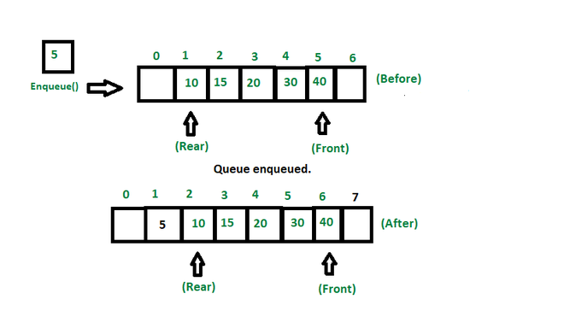
1. Enqueue()

Slide 42
2. Dequeue
Removes (or access) the first element from the queue. The following steps are taken to perform the dequeue operation:
Step 1: Check if the queue is empty.
Step 2: If the queue is empty, return the underflow error and exit.
Step 3: If the queue is not empty, access the data where the front is pointing.
Step 4: Increment the front pointer to point to the next available data element.
Step 5: The Return success.

Slide 43
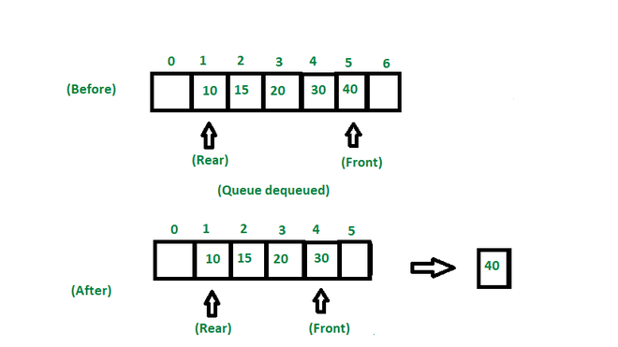
2. Dequeue

Slide 44
3. front()
This operation returns the element at the front end without removing it.

Slide 45
4. rear()
This operation returns the element at the rear end without removing it.

Slide 46
5. isEmpty()
This operation returns a boolean value that indicates whether the queue is empty or not.

Slide 47
6. isFull()
This operation returns a boolean value that indicates whether the queue is full or not.

Slide 48
Practice
https://leetcode.com/tag/queue/
https://leetcode.com/problems/design-circular-deque/description/
https://leetcode.com/problems/dota2-senate/description/

Slide 49
References
<List out the main documents are used to develop this material>
<List out the further reading documents>

Slide 50
Lesson Summary
<Summarize the main points in the lesson, compared to the lesson objectives>

Slide 51
THANK YOU!

